Slide 1
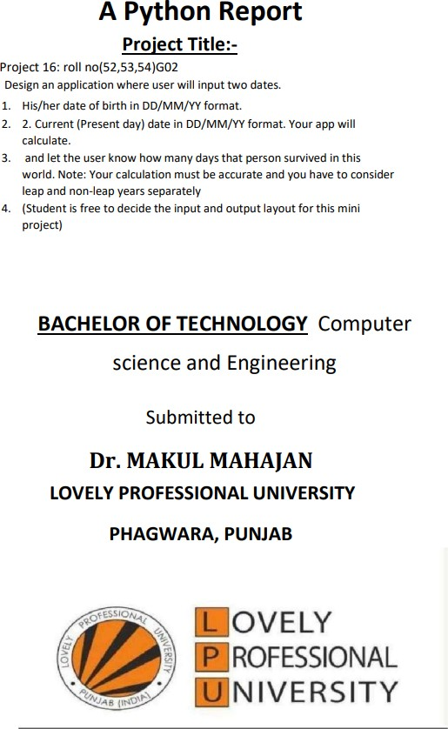
NAME:- DEEPAK SINGLA ROLL. NO.- 52
REGD.NO.- 12220033

Slide 2
class Date:
def__init__(self, d, m, y):
self.d = d
self.m = m
self.y = y
monthDays = [31, 28, 31, 30, 31,
30,
31, 31, 30, 31, 30, 31] def
countLeapYears(d):
years = d.y
if (d.m <= 2):
years = 1 return int(years / 4) - int(years / 100) +
int(years / 400) def getDifference(dt1, dt2): n1 = dt1.y *
365 + dt1.d for i in range(0, dt1.m - 1):
n1 += monthDays[i] n1 +=
countLeapYears(dt1) n2 =
dt2.y * 365 + dt2.d for i in
range(0, dt2.m - 1):
n2 += monthDays[i] n2 +=
countLeapYears(dt2) return (n2 -
n1) print("Enter your date of
birth:)") d1=int(input("Day:"))
m1=int(input("Month:"))
y1=int(input("Year:"))
print("Today Date>")
d2=int(input("Day:"))
m2=int(input("Month:"))
y2=int(input("Year:")) dt1 =
Date(d1, m1, y1) dt2 = Date(d2,
m2, y2) if y2<y1:
p=("Invalid Date of Birth\nBut Difference Between two Dates is
") x=("If We InClude End Day") r=getDifference(dt1, dt2)
print(p,-1*r,"\n",x,-1*r+1) else:
l=getDifference(dt1, dt2)
print(l, "Days You Are survieved in this World!")
print("If We Include End Day:",l+1)

Slide 3
